Slide 1
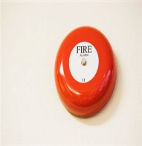
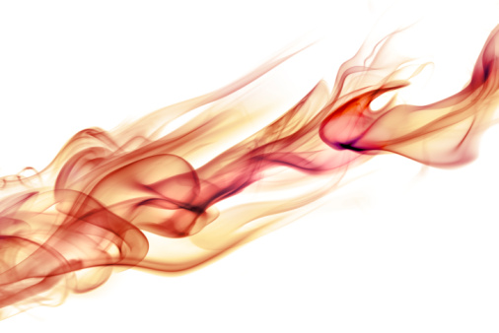
Fire Safety Awareness
Fire Safety

Slide 2

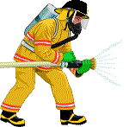
Mandatory Training
Mandatory Training
Why do we do this training:
The Trust have a Duty of Care to ensure your safety
Legal requirements
1500 Fires per annum in Healthcare premises
Fire Safety

Slide 3
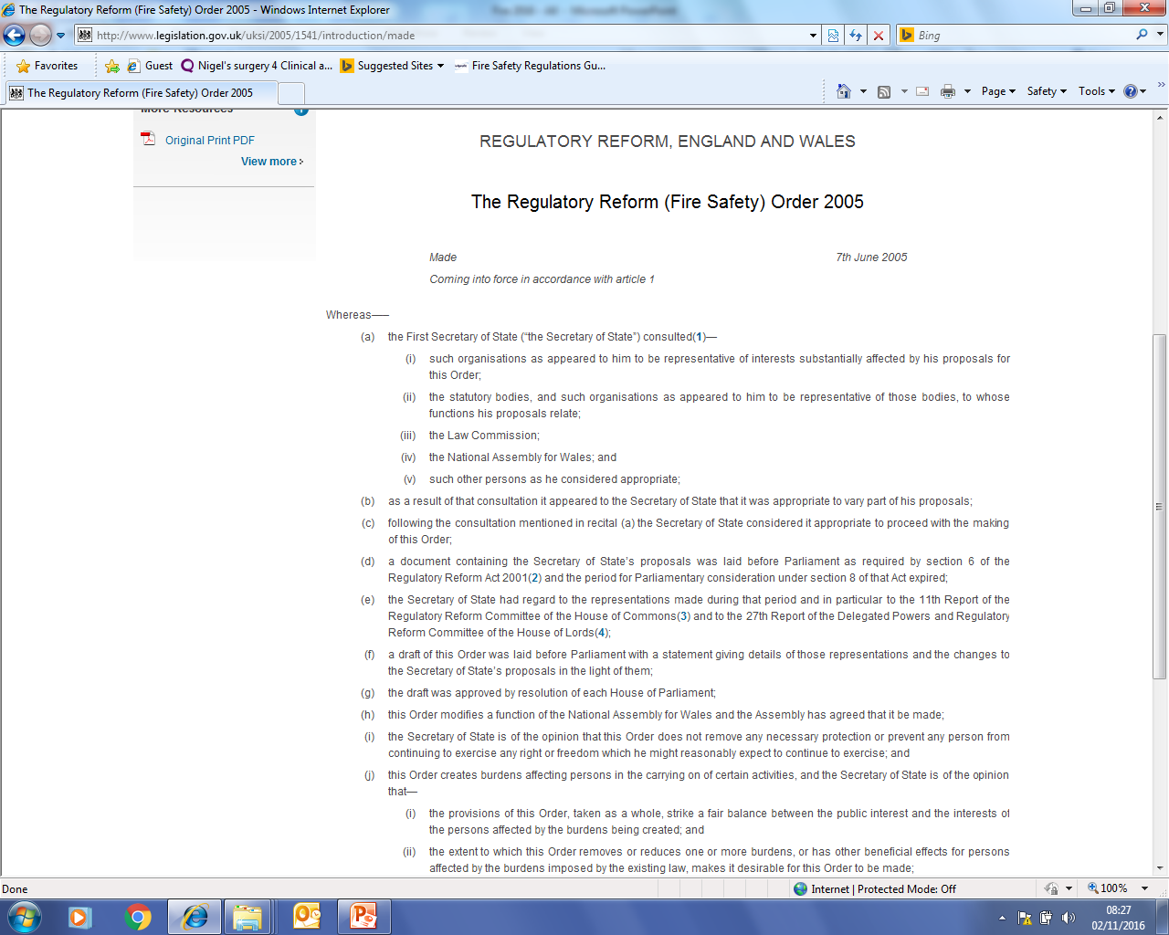
Legislation – Fire Safety Order
Click on link to watch a fire in a shop
Fire Safety

Slide 4
Other legislation and guidance includes:
Management of health and safety regulations 1999
Health and Safety at Work Act 1972
Approved document B
Health Technical Memorandum 05-01 / 05-02 / 05-03

Slide 5

Fire Safety Awareness
AIMS:
To give you an understanding of :
The Nature of Fire
Fire Hazards and Risk
Fire Prevention
Local Fire Procedures
Fire Safety

Slide 6

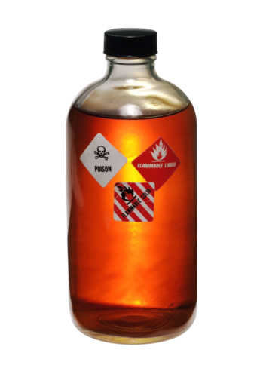
The Elements of Fire
Sources of Fuel
Paper & Cardboard
Furniture / Linen
Waste materials
Chemicals – Fuel – Solvents
Oxidizing agents - accelerate the combustion of other materials
Hazards
Increases Fire Loading
Blocks exits and evacuation routes
Risk of slips and falls
Arsonists
Ignites if stored next to an appropriate ignition source
FUEL
Fire Safety

Slide 7
The Elements of Fire
Surgical Fires
Chloraprep isopropyl alcohol (IPA) 70% - incomplete drying of the solution - flammable
Awareness diathermy unit ignites the alcohol based antiseptic or the vapours if not allowed to dry fully and if its in an oxygen enriched environment ???????
Perclot - controls bleeding - potato starch base – flammable Awareness - If not used correctly along with a diathermy unit in an oxygen enriched environment ???????

Slide 8
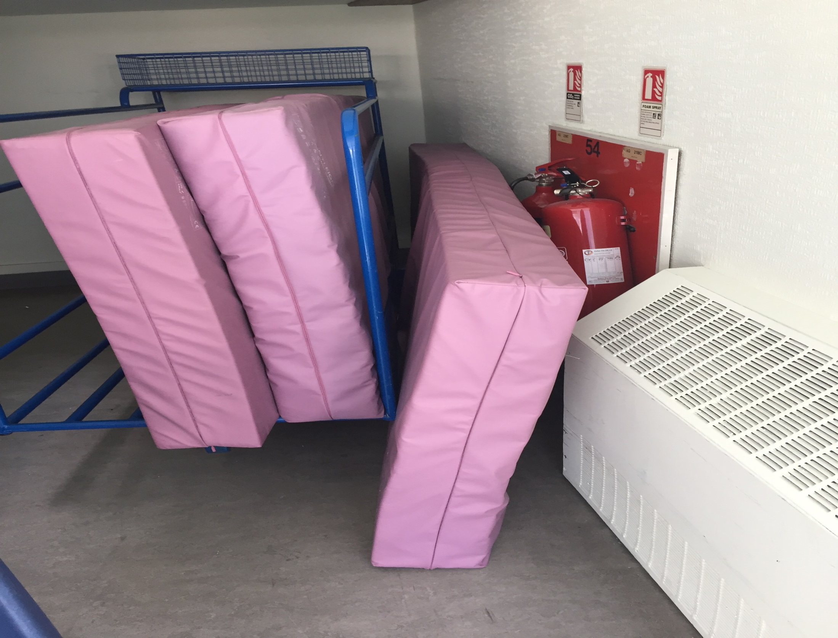
Poor access to Fire Extinguisher

Slide 9
The Elements of Fire
Sources of Heat / Ignition
Sparks – Grinders - Friction
Electrical equipment such as toasters, heaters, diathermy units, mobile phone chargers – Look for scorch marks or signs of damage, risk assessment
Smoking materials – E-cigarettes
Naked flames
HEAT
Fire Safety

Slide 10
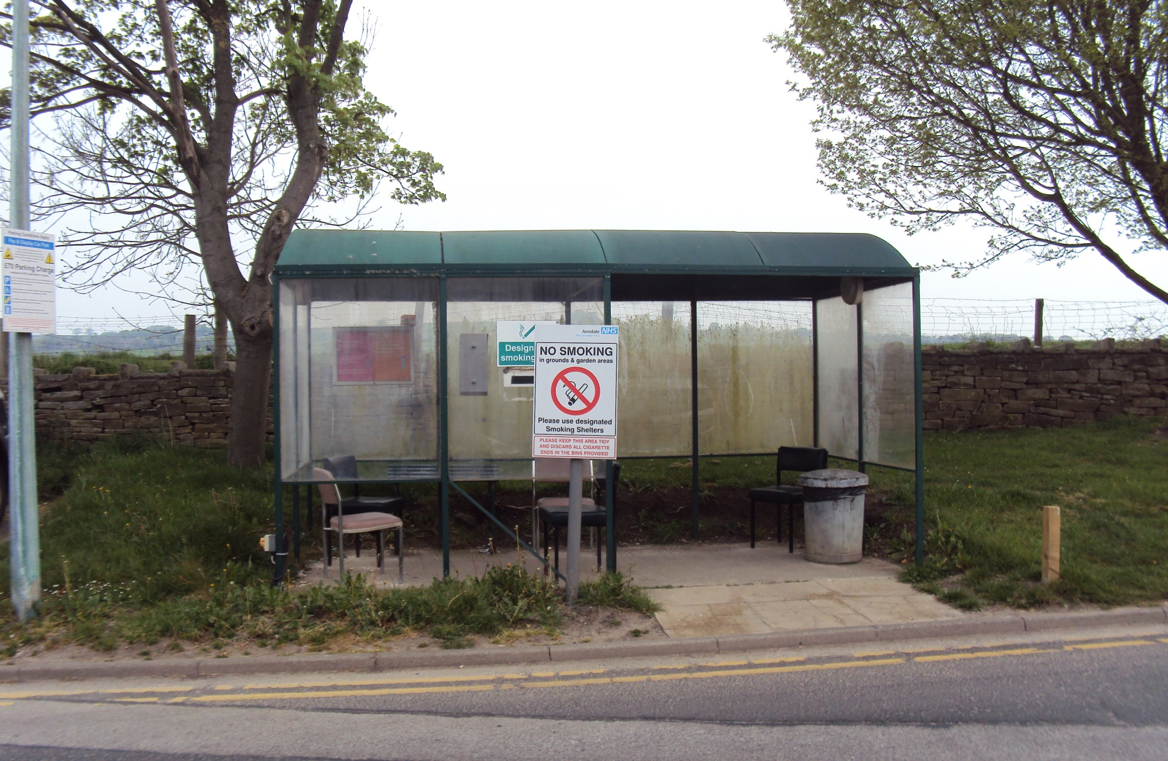
Smoking Shelter
If in place they need to be sited away from the building

Slide 11
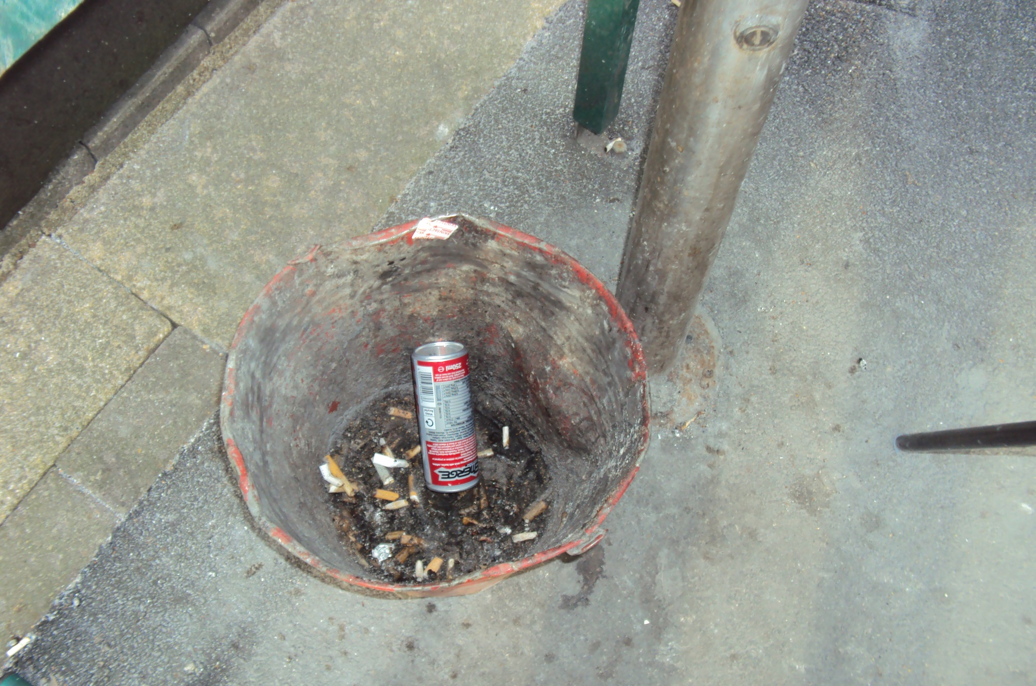
Fire Bucket

Slide 12
The Elements of Fire
OXYGEN is readily available in
the atmosphere
The best way to prevent extra OXYGEN getting to a fire is:
Don’t wedge open fire doors
Ensure oxygen valves are shut off when not in use
Know how to Isolate Medical Gases
OXYGEN
Fire Safety

Slide 13
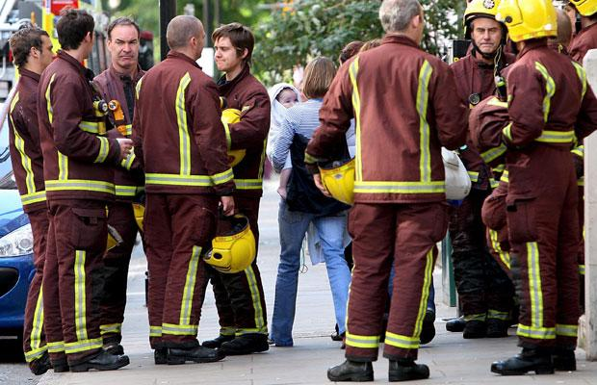
Hospital Fires
Great Ormond Street Fire
Total Cost; £11,000,000
Casualties none - Partial evac – sept 2008
One particular issue identified during the movement of children to a safe area was notes were left behind on the ward and electronic records were not kept. In addition, they were not tracked and staff had to telephone other areas to locate them
Royal Marsden Fire
Total Cost; £17,000,000
Casualties none –Full evac - Jan 2008
Fire Safety

Slide 14
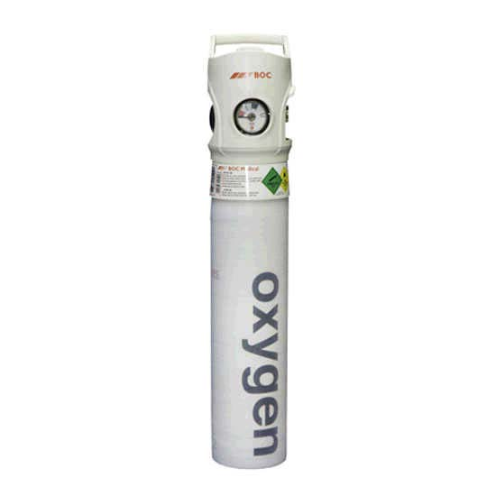
Medical Gases
Please ensure:
Flow meters are turned off.
Cylinders are stored correctly in a secured area if not in use
If empty or expired contact porters to have them taken away

Slide 15
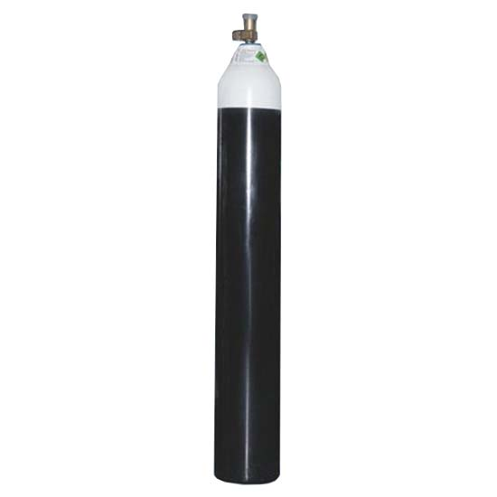
MEDICAL gASES
Do not lubricate any parts on the cylinder with oil or grease
When using alcohol gels – give the alcohol time to evaporate before handling.
If you encounter any problems contact the porters

Slide 16
Creams
Patients need to be informed of the flammable hazards of emollient creams or paraffin based creams especially smokers.
Healthcare professionals should advise patients not to smoke or go near naked flames because clothing, bedding, dressings, and other fabrics that have been in contact with an emollient or emollient-treated skin can rapidly ignite. Washing these materials at high temperature may reduce emollient build-up but not totally remove it.

Slide 17

FIRE SCIENCE
When all the elements come together!
Fuel for fire to burn, oxygen for the fire to breathe and heat an ignition source and for the fire to continue to burn.
HEAT
The Fire
Triangle
CHEMICAL
CHAIN
REACTION
OXYGEN
FUEL
Fire Safety
Notes:
Fire is a chemical reaction caused when heat, fuel and oxygen come together. Fuel for fire to burn, air for the fire to breathe and heat an ignition source and for the fire to continue to burn. The absence of any one of these three elements will prevent a fire starting. Prevention depends on avoiding these three coming together. Fire extinguishing depends on removing one of the elements from an existing fire.

Slide 18
Fire Safety Awareness
Portable Appliances
Any equipment that has a plug and lead
Inspect for damage prior to use:
Plug.
Cable
Socket
Appliance
IF IN DOUBT – DO NOT USE AND REPORT FOR REPAIR
Fire Safety

Slide 19
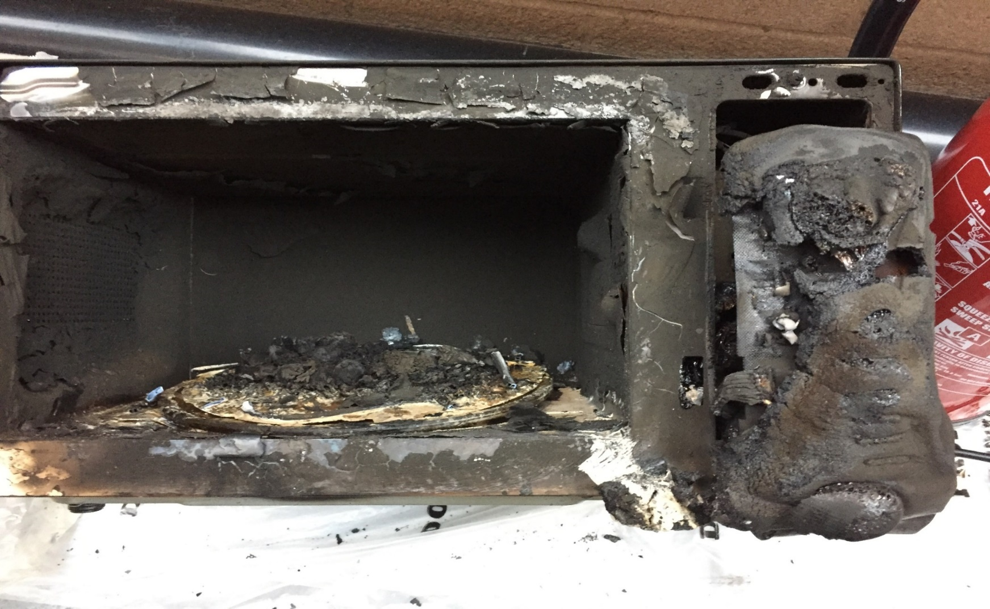
Microwave Fire
Stay with the microwave when it is in use. See next slide for what happened next

Slide 20
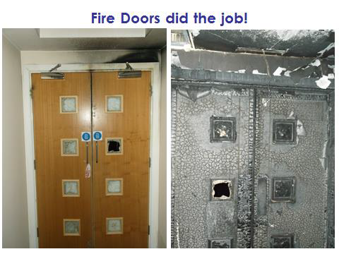

Slide 21
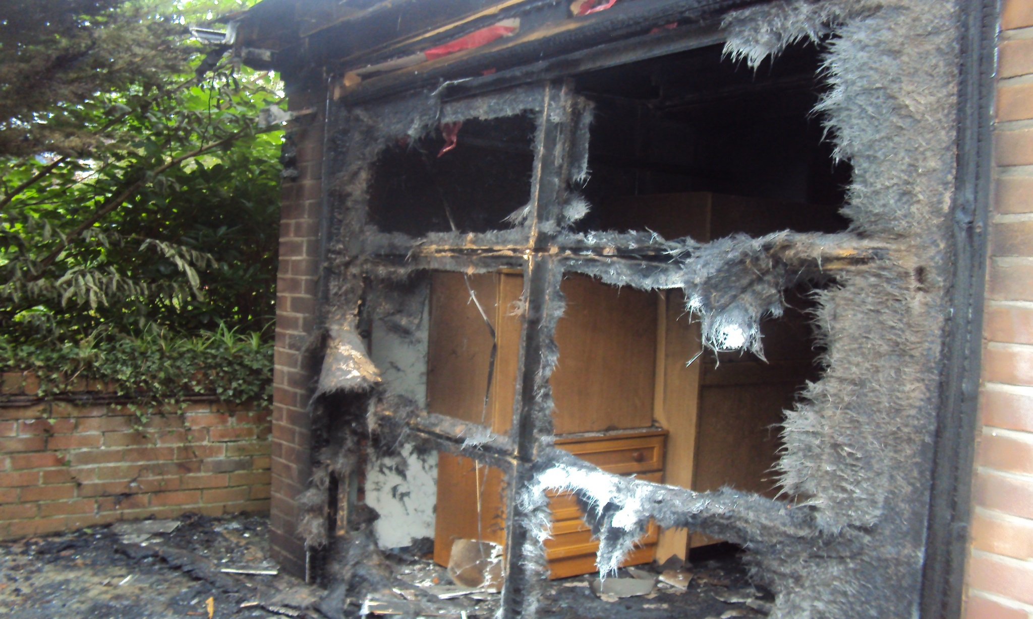
Garage Doors caused by cooking
Fire Safety

Slide 22
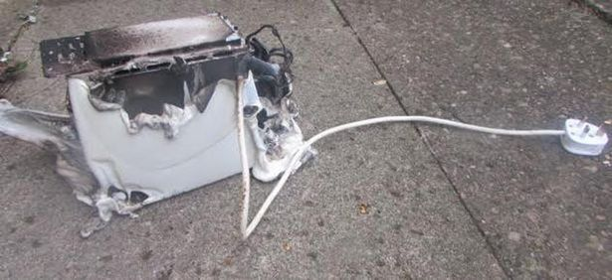
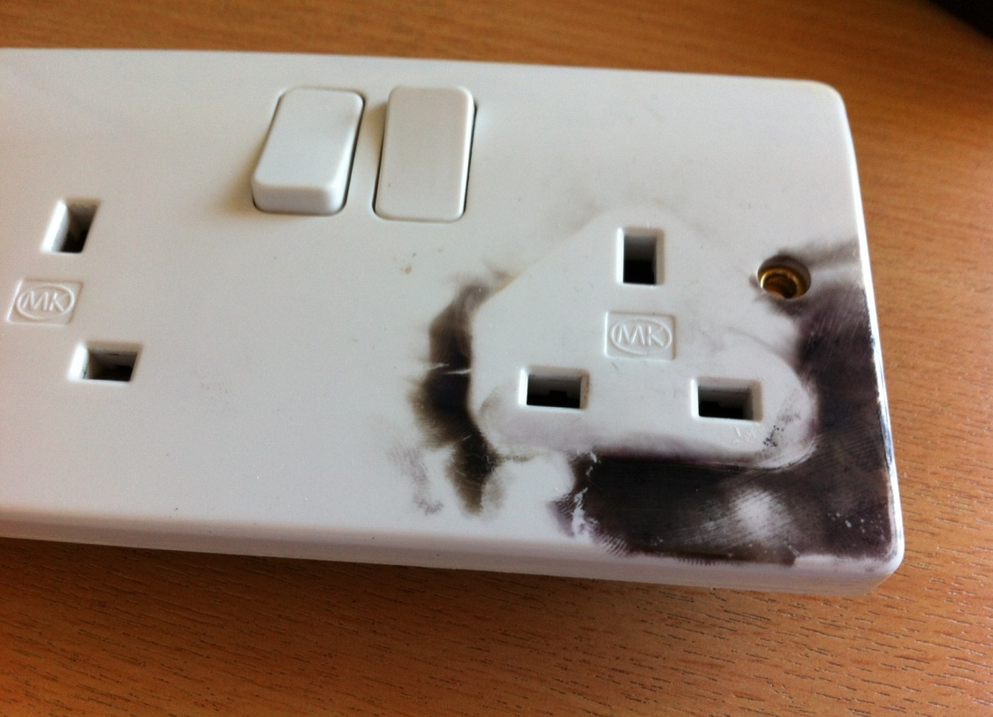
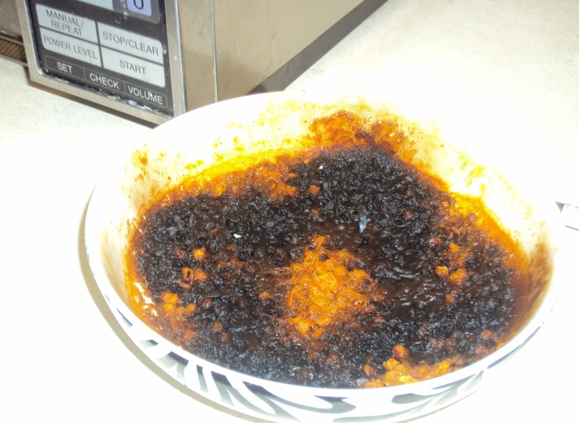
3 photos, fire in residences on site, occupant put a pizza in the oven still on the polystyrene base packaging and then left the building to go to the shops!
The socket is the result of a cheap charging device exploding
Failure to follow instructions on the tin to heat soup!!! Each time the user left the area with the appliance switched on
Soup Microwaved for 15 minutes
Fire Safety
Notes:
Top 2 photos, fire in residences on site, occupant put a pizza in the oven still on the polystyrene base packaging and then left the building to go to the shops!
The socket is the result of a cheap charging device exploding
Failure to follow instructions on the tin!!!
All happened on this site.

Slide 23
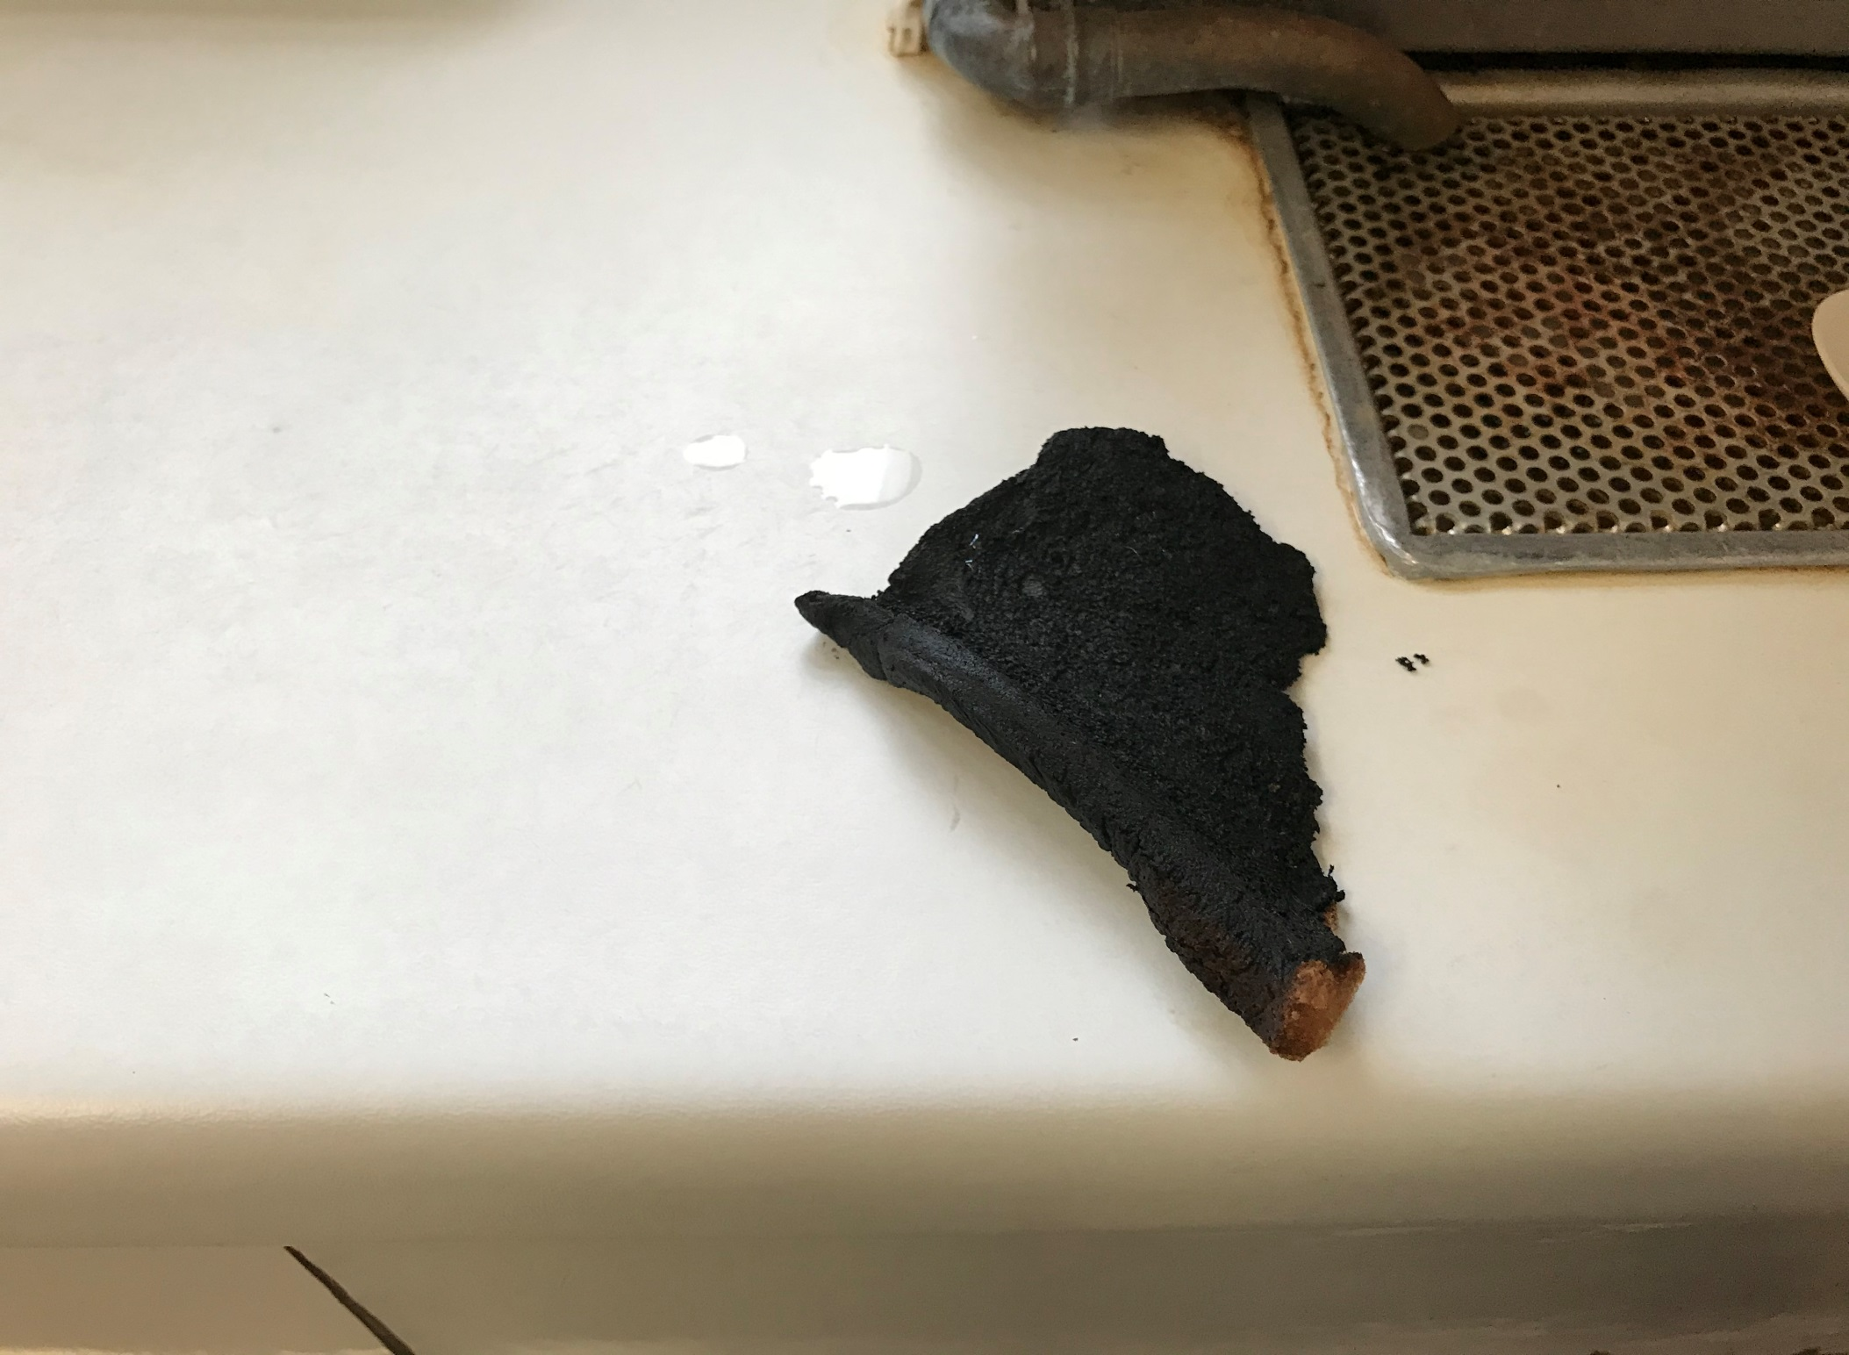
Burnt toast – toaster left on its own jammed and kept on toasting

Slide 24
Cheese on Toast
Faulty toaster – melted – user left the area ---AGAIN.
Fire Safety

Slide 25
Arson
The Most Common Causes of Fire Are:
Arson – 2% of arson fires in UK businesses is in healthcare premises
Faulty electrical appliances up to 14,500 per year
Smoke caused the majority of deaths
If you see someone acting suspiciously, please contact security
Fire Safety

Slide 26

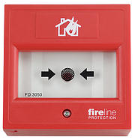
Fire Alarm
If you discover a Fire
When confronted with a fire or smoke, remember the correct procedures to follow:
Alarm others in the area by activating the nearest fire alarm and dial 6666 on the nearest safest phone. and inform switchboard of the location of the fire, or suspected fire
Ask all visitors to evacuate the area
Confine the fire by ensuring fire doors are closed
Prepare patients for evacuation to an adjacent area
Fire Alarm Call Point
Fire Safety

Slide 27

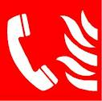
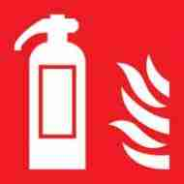
General Hospital
Sample Staff Fire Procedure
If You Discover, or Suspect a Fire
Raise the alarm immediately by breaking the glass on the nearest Fire Alarm Call Point.
Dial 6666 on any internal telephone in a safe area and inform switchboard of the location of the fire, or suspected fire.
Attempt to put out the fire, but only if you have been trained in the safe use and selection of fire extinguishers.
Action on Hearing a Continuous Fire Alarm
Upon hearing a continuous fire alarm all staff will search the area for signs of fire.
If a fire is discovered, call 6666 on any internal telephone in a safe area and inform switchboard of the location of the fire and request the fire and rescue service.
Close all doors if safe to do so and evacuate the area.
If on completion of the search no fire is discovered call 6666 and report a false alarm.
Action on Hearing an Intermittent Fire Alarm
An intermittent alarm sounding indicates that there is a potential fire somewhere in your adjacent areas. If the red indicator light opposite the nurse station is flashing on a ward it indicates that there is a continuous fire alarm activating directly below or above you depending where you are geographically on site, level 1 or level 2, send someone to the area to check on the situation. If it is a fire, prepare for evacuation. Evacuate if your intermittent alarm turns into a continuous alarm. All areas should check fire panel for location of continuous alarm. The fire response team will attend if a fire is confirmed.
Departments Fire Assembly Point: Bottom of the external ramp
Departments Alternative Fire Assembly Point: Internal area in an intermittent alert
Fire call - 6666: Fire call - 6666: Fire call - 6666: Fire call - 6666

Slide 28


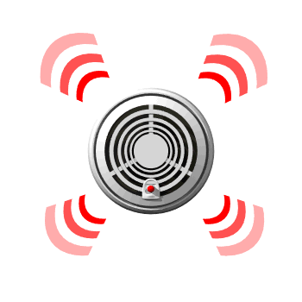
Continuous Alarm
This should not prevent the first steps of the fire procedure being put in place:
Inform patients and visitors of the situation
No new procedures being commenced
No new admissions being allowed
Preparing to start moving patients
Prepare to evacuate
Fire Safety

Slide 29
Fire Alarm
All areas HEARING AN INTERMITTENT ALARM should check the nearest fire panel for location of continuous alarm. The fire response team will attend if a fire has been confirmed.
The Fire Response Team will take over the situation
until the arrival of the Fire Brigade.
•Alarms will continue to sound in the immediate area of the fire in a continuous tone
The adjacent areas and the floors above and below the fire, will sound in an intermittent tone
Fire Safety

Slide 30
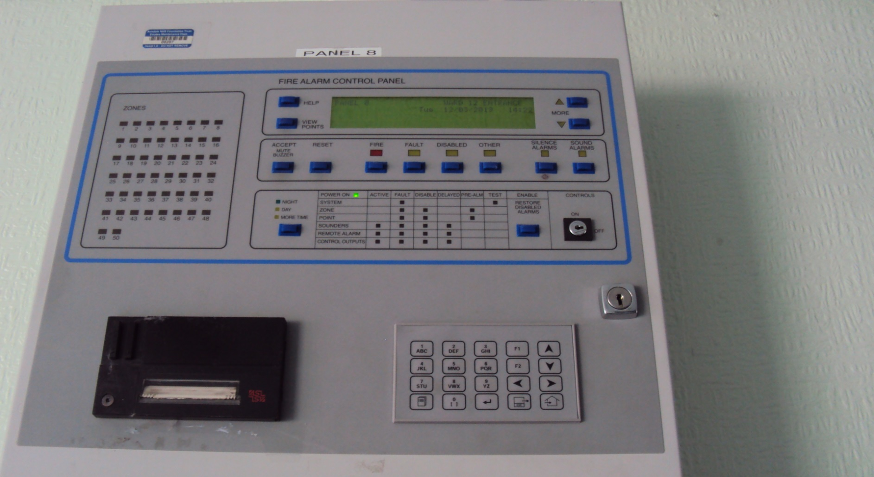
Typical Fire Panel where's your nearest one

Slide 31
Intermittent Alarm
Action by Staff Not in the Fire Area – (Intermittent Alarm)
An intermittent sound of the alarm occurs in all adjacent compartments to the area in continuous alarm .
Staff member should tell all patients and visitors they are in a safe area. All staff should be aware that they may be needed to help evacuate patients in the adjacent fire zone.
Staff in the area where the fire alarm is sounding intermittently, should be aware of the need to prepare for the next action in the fire plan, this may involve evacuation. All areas in an intermittent alert should report to and check their nearest and safest fire panel for the location of the continuous alarm.
Fire Safety

Slide 32
Fire Alarm
All areas should check fire panel for location of continuous alarm. The fire response team will attend if a fire is confirmed.
The Fire Response Team will take over the situation
until the arrival of the Fire Brigade.
•Alarms will continue to sound in the immediate area of the fire in a continuous tone
The adjacent areas and the floors above and below the fire, will sound in an intermittent tone
Fire Safety

Slide 33
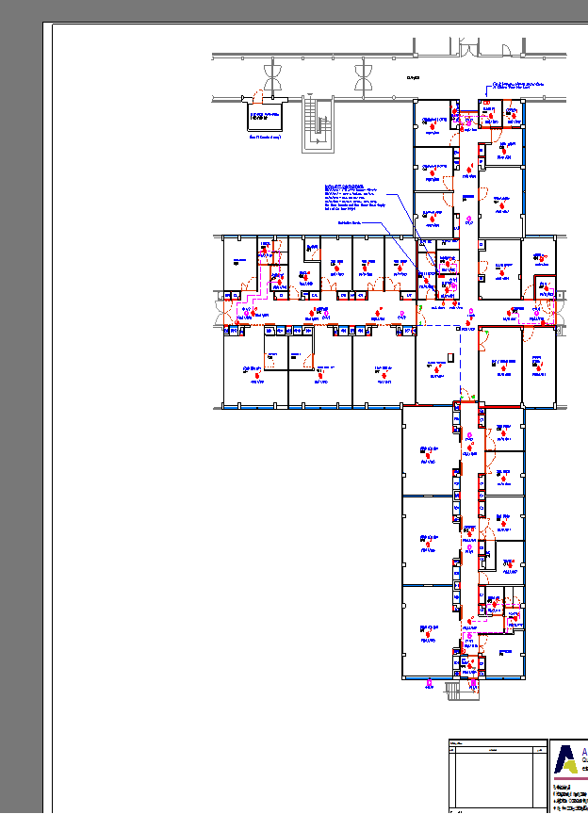


Slide 34
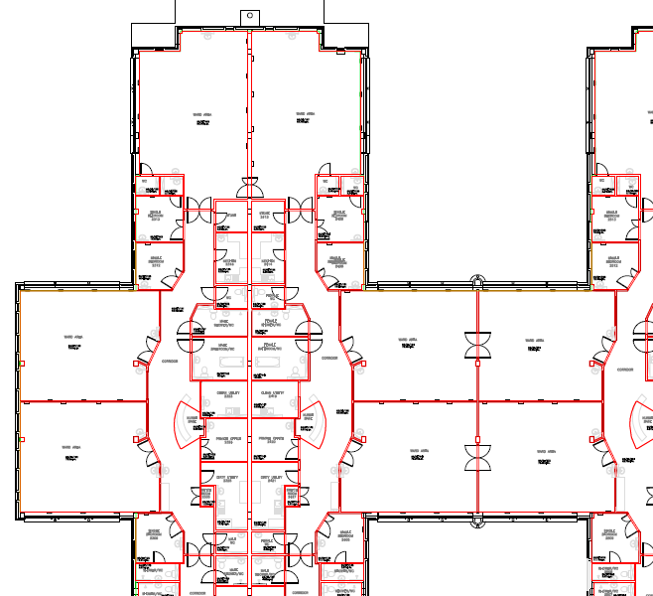

Phased Horizontal Evacuation
Continuous Alarm
Intermittent Alarm
Ward 1
Ward 2
Ward 23
Fire Safety
Intermittent Alarm
Notes:
Ward 24 simulated fire and horizontal evac

Slide 35
Evacuation
Evacuation will be ordered if: –
The fire / smoke cannot be controlled, or people are in immediate danger.
Evacuation will normally entail moving in an horizontal direction to the next available safe area where the alarm tone is either intermittent or not sounding or to an external area
Fire Safety

Slide 36
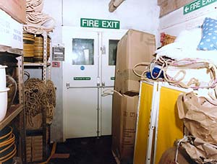
housekeeping
Fire Exit:
Don’t obstruct fire exits,
Observe good house keeping
Don’t wedge Fire doors open
Fire Safety

Slide 37


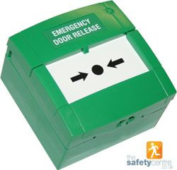
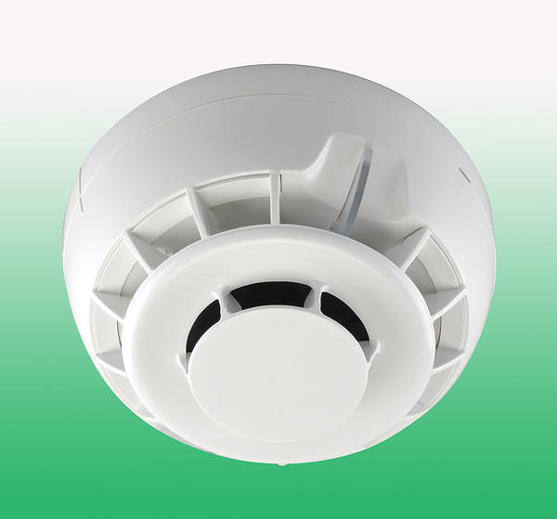
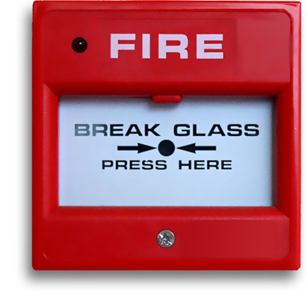

devices
Raise the alarm
Emergency Exit button
Usually Green / White
Detectors
Fire Safety

Slide 38
Actions in the event of fire
Raise the alarm - press
Tackle the fire only if safe to so do – no danger and escape available
Evacuate the patients to a safe area - usually two fire doors
Close doors if safe
Await further information from attending fire team.

Slide 39
Actions in the event of fire and evacuation
Emergency break glass unit coloured green or white for door access purposes, if the PAC system does not release or if the door is not linked to the alarm system and does not release on fire alarm activation press the centre button,

Slide 40


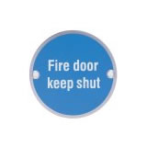
Signage
Directional Fire
Safety Signs
will point to the
evacuation routes
there are at least
two routes, so you
can always walk
away from a fire
Typical Fire Door Signage which is Mandatory and must be followed
Fire Safety

Slide 41
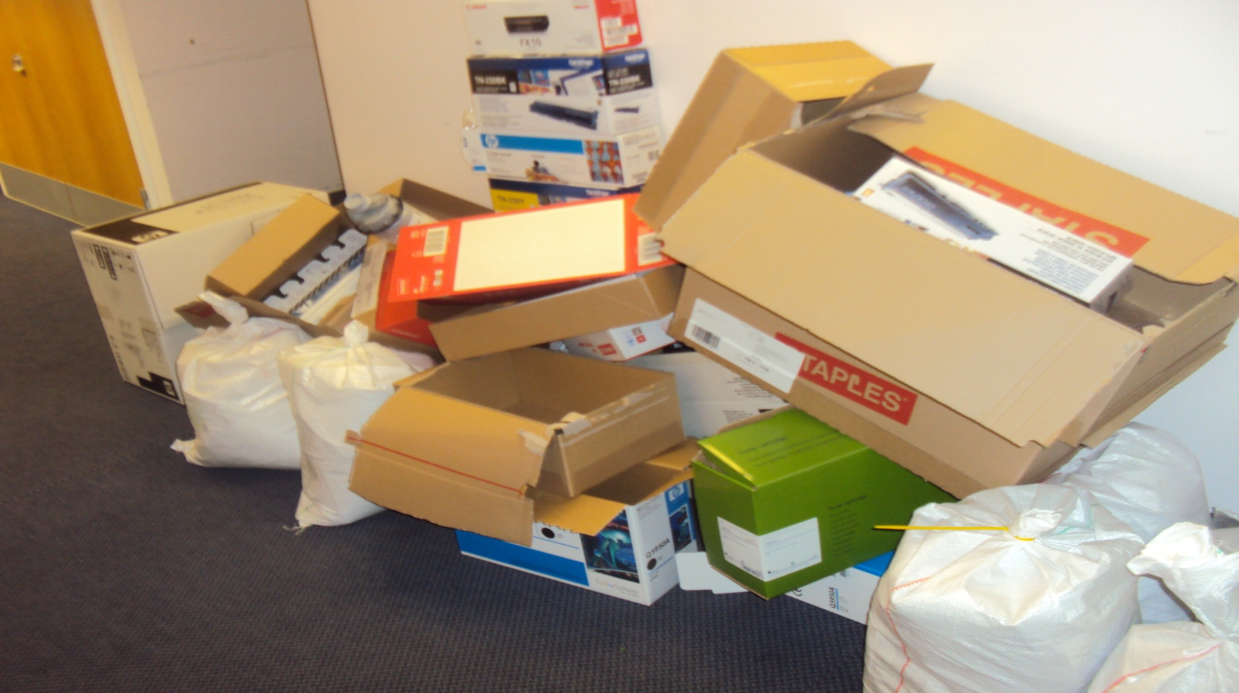
Rubbish on Corridor

Slide 42
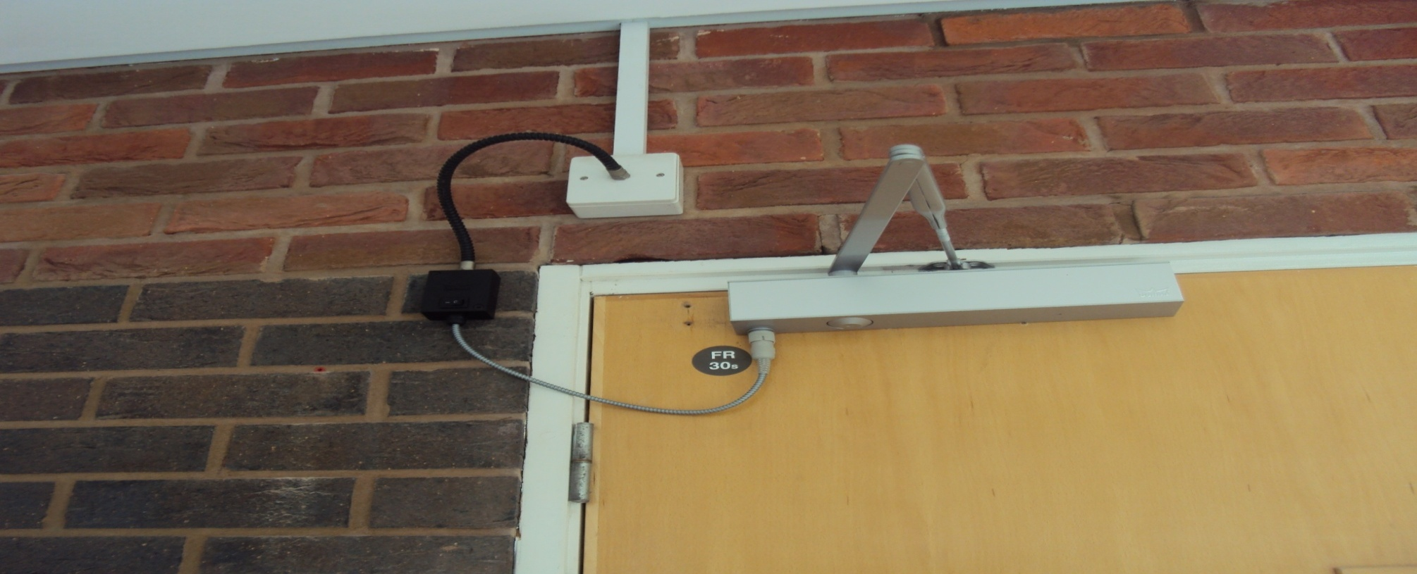
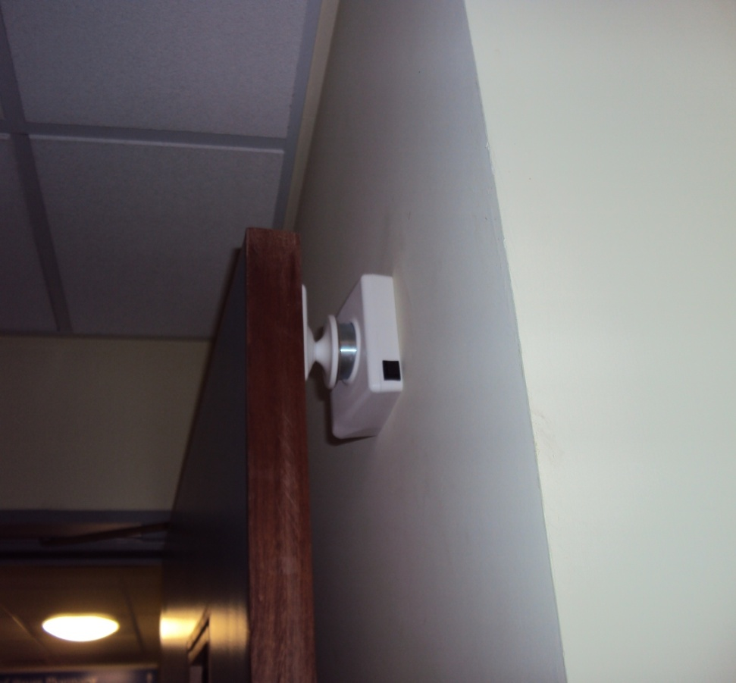
Fire door release systems
Electrical hold open devices
release the door when the
fire alarm activates
Electrical hold open devices
release the door when the
fire alarm activates
Magnetic hold open devices
release the door when the
fire alarm activates
Fire Safety

Slide 43
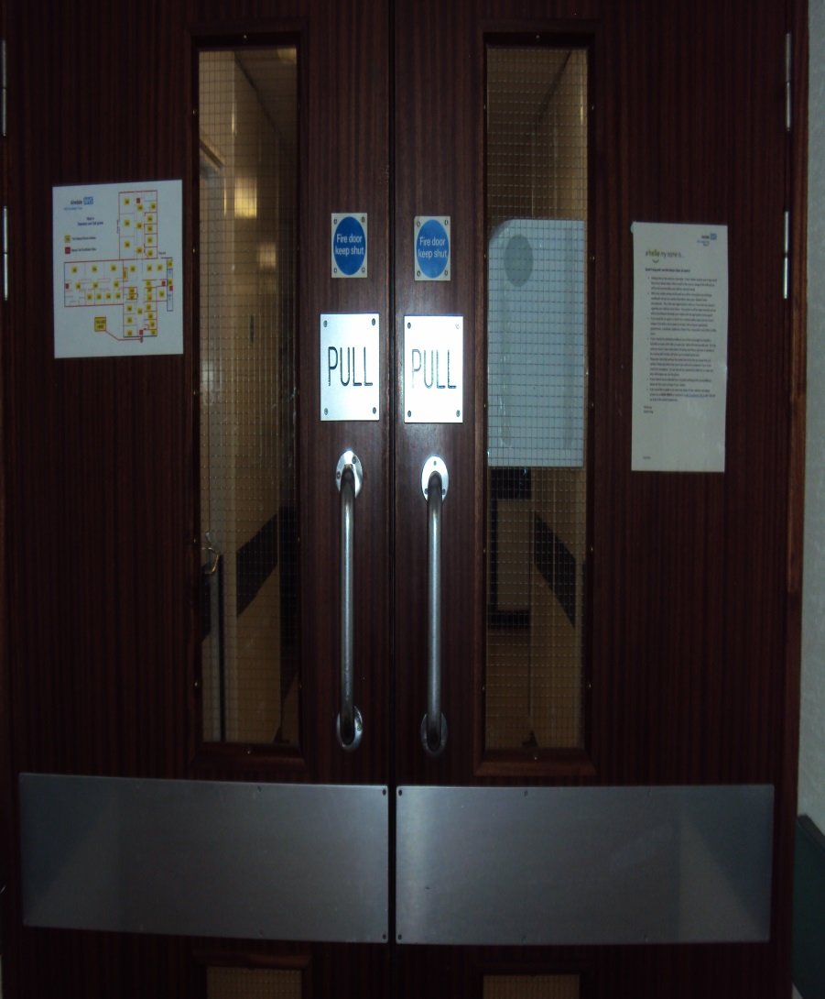

Fire door seals
Seals when in good condition can give up to 30 minutes protection from smoke fumes
Door structure can give up to 60 minutes protection from flames
Please do not ram the doors open with trolleys open them manually onto their holdback devices
Fire Safety

Slide 44
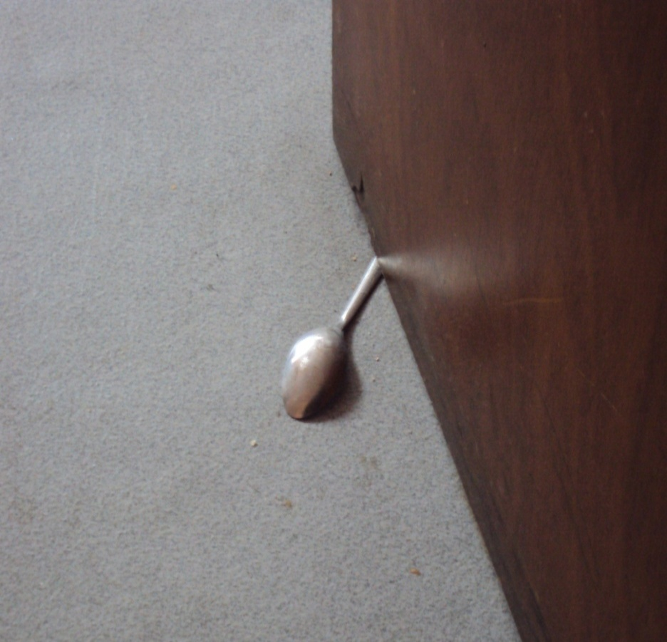
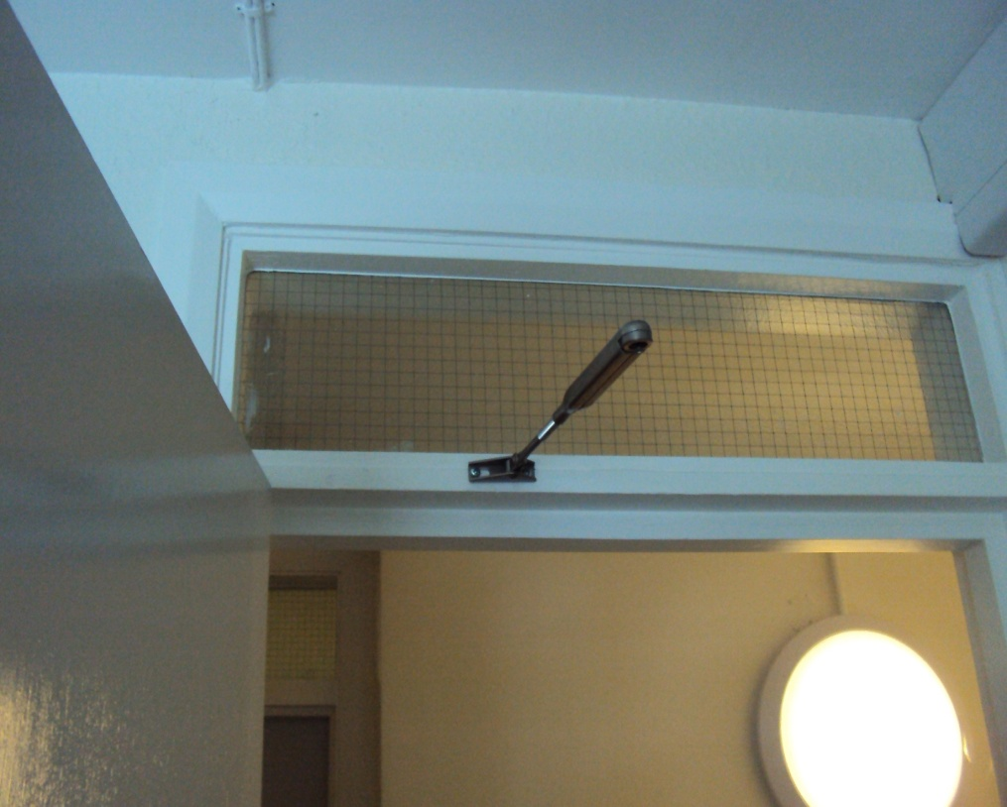
Illegal hold open devices
These don’t release when
the fire alarm activates
This won’t automatically
close behind you
Fire Safety

Slide 45
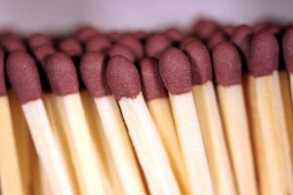
What you can do to prevent fire
keep fire doors shut at all times
ensure escape routes are clear
if you see, or smell smoke, activate the alarm
https://www.gov.uk/workplace-fire-safety-your-responsibilities/who-is-responsible
If you notice damaged Fire Equipment / Fire Doors notify ESTATES immediately.
Fire Safety

Slide 46
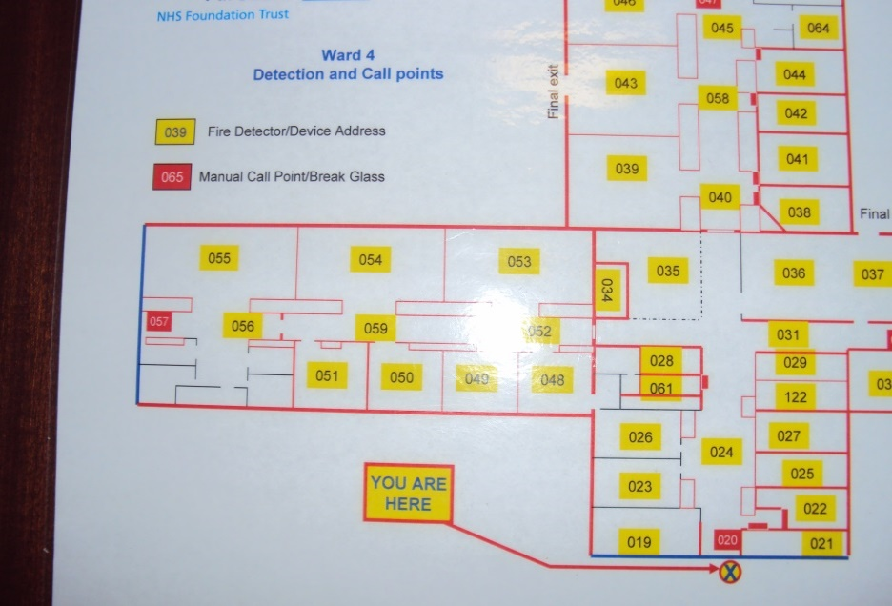
FIRE ACTIONS
What to do in case of fire
sound the fire alarm
do not use the lifts.
Check the Fire Panel to identify the location and Evacuate when / if asked to do so. Ask you fire officer for training on the fire panel
Fire Safety

Slide 47
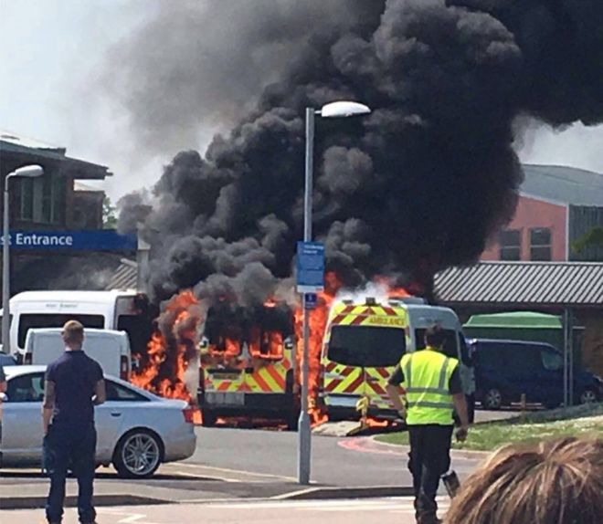
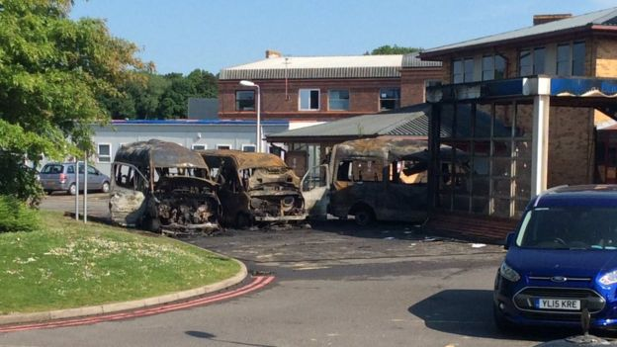
Electrical Fault Fire destroys 3 ambulances outside East Surrey Hospital
Fire Safety

Slide 48
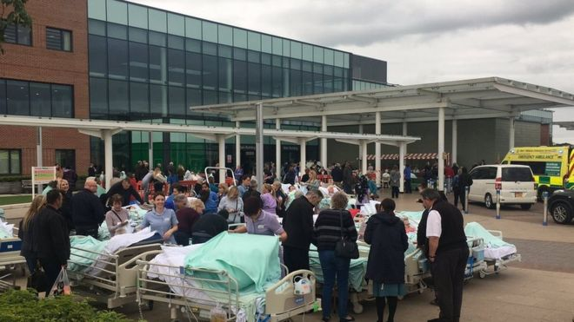
evacuation
June 7th 2017
The fire at the hospital was declared a major incident and led to the evacuation of hundreds of patients
Fire Safety

Slide 49
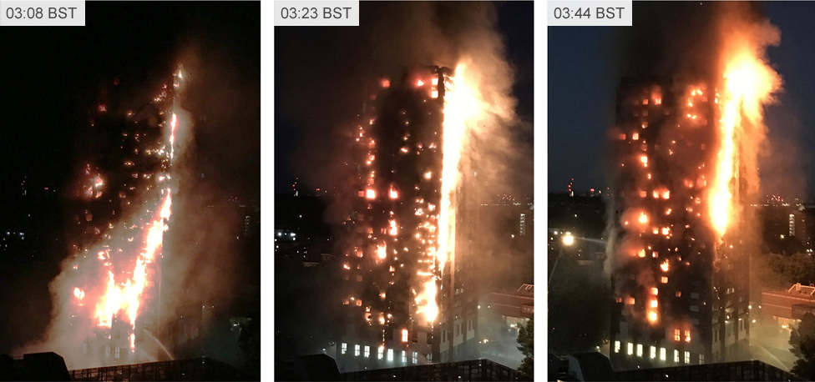
Grenfell tower fire 2017
Fire started at approx - 00.50 – 74 deaths – Faulty fridge
Fire Safety

Slide 50
Everyday Fire Safety
Domestically - Rented
Electrical Common Causes
14% washing machines (1,723)
12% tumble dryers (1,456)
11% dishwashers (1,324)
9% cookers (1,080)
Gas Appliances
http://www.electricalsafetyfirst.org.uk/product-recalls/
Fire Safety

Slide 51
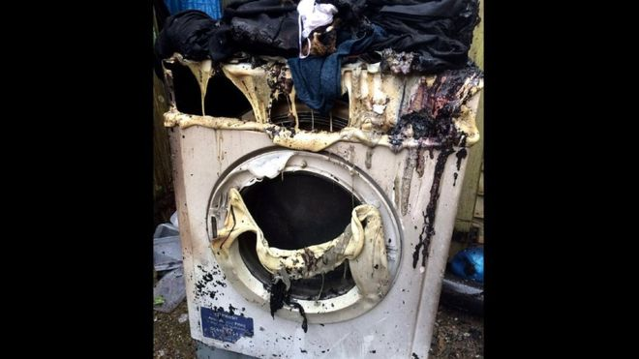
Fire Safety

Slide 52
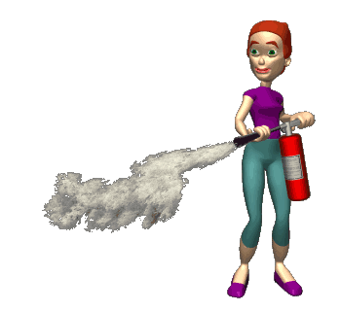
Fire
Extinguishers
Fire Safety

Slide 53
Fire Extinguishers
Follow the acronym:
PASS to use a fire extinguisher:
Pull the pin
Aim low, at the base of the fire
Squeeze the handle. Stand about ten feet from the fire.
Sweep the hose from side to side
Fire Safety

Slide 54
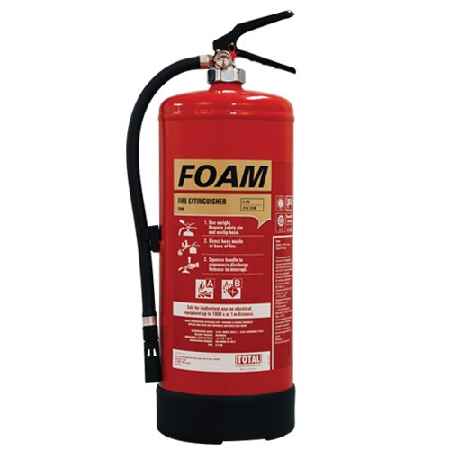
Foam extinguishers
Red Body with Cream label.
Suitable for Flammable liquids, petrol, solvents etc
Not suitable for use on fires
involving Electricity;
Extinguishes by cooling and sealing the surface of a burning liquid.
Fire Safety

Slide 55
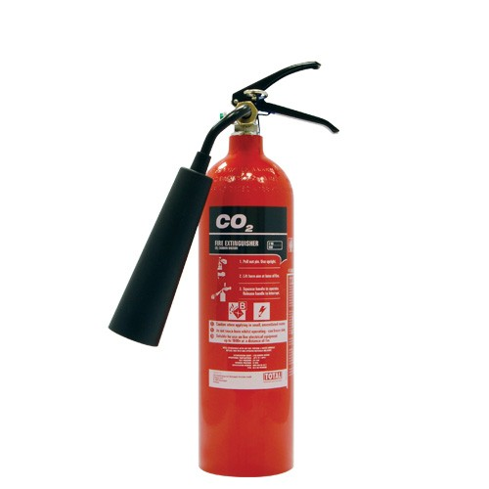
Carbon dioxide [CO₂]
extinguishers
Red body with black label
Safe to use on all fires except oil and fat fires.
Safe to use on fires involving electricity;
Extinguishes by reducing oxygen levels and cooling.
Fire Safety

Slide 56
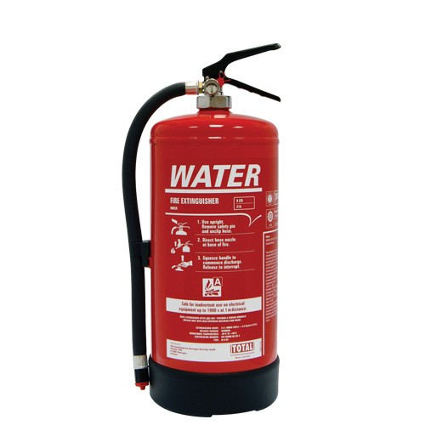
Water extinguishers
Red body
Suitable for wood fires, furniture and paper etc.
Not suitable for combustible liquids, Oil, Petrol, cooking fats etc.
Not safe to use on fires involving electricity;
Extinguishes by cooling
Fire Safety

Slide 57
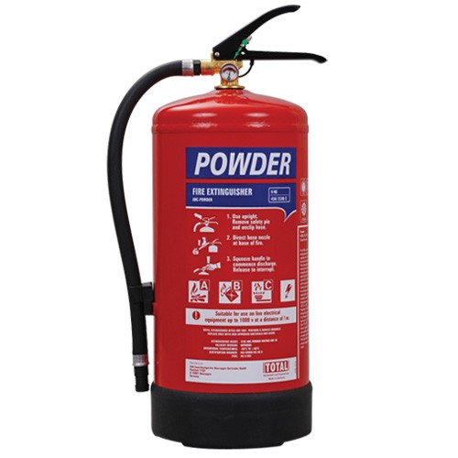
Powder extinguishers
Red body with blue label.
Safe to use on all fires except oil and fat fires.
Works by chemically Interfering with the combustion reaction
Fire Safety

Slide 58

Questions
Q & A
Fire Safety

